Slide 1
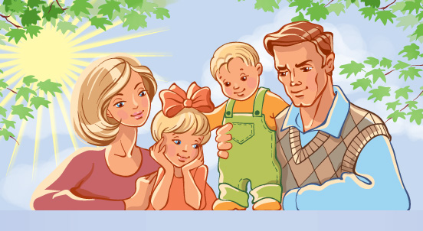
My family.

Slide 2
Тип урока: комбинированный по теме « Семья». Урок изучения новых знаний. Цели урока:
Обучающие: обобщить знания лексики по теме “Моя семья”; активизировать лексико-грамматический материал (possessive case) в устной и письменной речи;тренировать навыки аудирования, умения высказывать свое мнение по теме;развивать навыки монологической и диалогической речи; активизировать в речи лексический и грамматический запас, расширить знаний о стране изучаемого языка.
Развивающие: развитие критического мышления, развитие творческих способностей, расширение кругозора, развитие памяти и сообразительности.
Воспитательные: воспитание и уважение к родителям и семье; пробудить интерес к изучению иностранного языка; формирование познавательной активности учащихся. создание условий для формирования способности к критическому мышлению, формирование потребности и способности к сотрудничеству и взаимопомощи в группе.
Технология: элементы технологии критического мышления. Оборудование: презентации: My Family»,текст для чтения, таблицы.
Find the theme of our lesson in a sentence among these words: a map, a globus ,a computer, a family, a country.

Slide 3
Complete the claster.
grandparents
parents
relatives
family

Slide 4
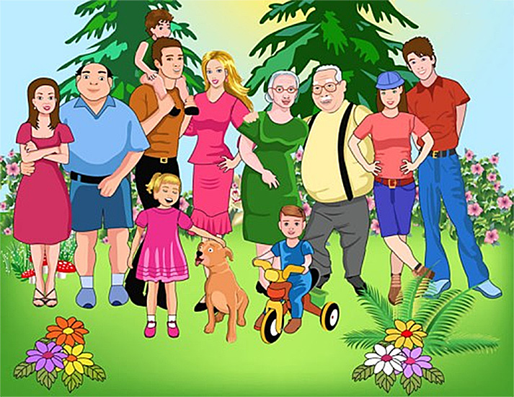
Family members:
Grandfather - дедушка
Grandmother - бабушка
Father – папа
Mother - мама
Brother - брат
Sister - сестра
Son - сын
Daughter - дочь
Uncle - дядя
Aunt - тетя

Slide 5
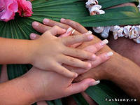
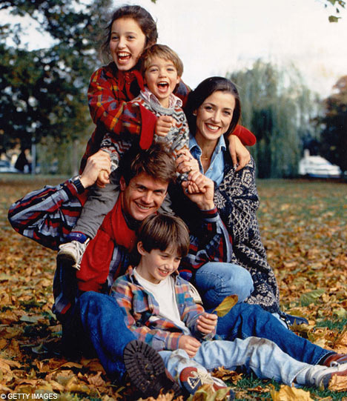
Age -возраст
How old are you?
I am …

Slide 6
Numerals- числительные
twenty
seventy
thirty
eighty
ninety
forty
hundred
fifty
sixty
thousand

Slide 7
Possessive case – Притяжательный падеж имен существительных
Ann is Mike`s mother.
Анна – мама (чья?) Майка.
My brothers` names are Tom and David.
Имена (чьи?) моих братьев – Том и Давид.

Slide 8
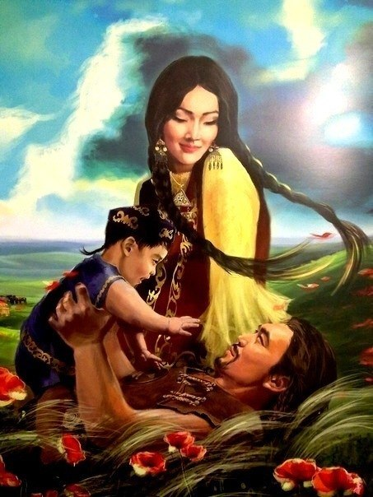
Meet my family

Slide 9
Read the text and translate.
My name is Aigul. I am 18. I was born in Astana. I am neither tall nor short. My friends say that I am pretty. My hair is fair and short. My face is oval, my nose is short and turned-up. My eyes are large and brown.
I like to dress well. I try to buy clothes which are in fashion. I am a polite girl. I try to be a kind, honest and serious person. I study at the technological college. I would like to notice that I am good at many subjects. I like Biology and Maths best of all. Also I like to read English books and learn poems and songs. I’m fond of music too. I like to listen to music and collect information about popular singers. Our family consists of my parents, my sister and I. We live in Pavlodar, in Chokina street. I can say that our family is small, and we love each other very much.
My mother's name is Gulnara Zhumataevna. She is 37. She is a teacher. She is a very nice woman. My father's name is Aman Ardakovich. He is 40.He is a driver. I am sure he is a skilled driver. My father is a very clever and kind man. I can always turn to him with my troubles.
I have a small sister. Her name is Aliya. She is 12.I like to take care of her. Sometimes we read funny stories, sometimes I go for a walk with my sister. Aliya is fond of painting. She spends a lot of free time painting trees, streets, flowers and animals.
All members of our family have their own hobbies. But we like to spend our weekend together. We go to the forest. In summer we pick up berries and mushrooms, in winter we prefer to be closer to nature and spend some free time in the country. We have a small comfortable house and a nice garden near it.

Slide 10
Insert
«v» | «+» | «-» | «?»
You should put a tick v if you knew this fact before (соответствует тому , что вы уже знаете) | New information (является для вас новым, интересным) | Thought differently (противоречит тому, что вы уже знали или думали, что знаете) | Don’t understand, have questions (непонятно или вы хотели бы получить более подробные сведения)

Slide 11
Complete the following sentences using the text.
1) Aigul is my… 2) I have got a… 3) My mother is… 4) She is a very nice … 5) My father is… 6) He is a skilled … 7) I can always turn to him ….8) All members of our family have …. 9) I have also….10) She spends a lot of free time painting….11) We spend some free time ….12) We have …and a nice garden near it.13) I like ….

Slide 12
Ask some questions about your family!
1.Is your family big or small? 2.How many people are there in your family? 3.Have you got any sisters or brothers? 4.What` s your mother`s/father’s name? 5.How old is she/he? 6.What is she/he? 7.What are they like? 8.What are their hobby?

Slide 13
True or false:
1)Aigul has got a mother, a father and a sister.
2)They live in Pavlodar, in Satpaeva street.
3)They love each other very much.
4)Her mother is a housewife.
5) She is forty-four but she looks much younger.
6) Her father is a very clever and kind man.
7) She can always turn to him with her troubles.
8) Her sister Aliya is ten.
9) She likes to take care of her.
10)She is fond of collecting stamps and coins.

Slide 14
Match the relatives:
Parents
Aunt
Uncle
Cousins
Granny
Grandpa
Sisters
Grandparents
father’s brother wife
father’s or mother’s mother
parents’ daughters
father’s or mother’s father
father’s brother
mother and father
aunt’s or uncle’s children
Granny and Grandpa

Slide 15
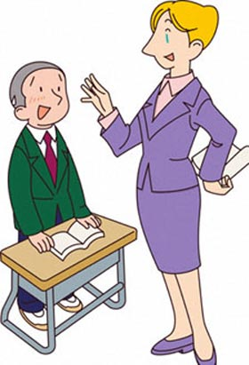
Make up similar dialogue about your family:
-Is your family large?
-Yes, our family is a large one. There are 5 of us. I have got a mother, a father, and two brothers.
-Are your brothers younger than you?
-No, they are both older.
I’m the youngest child in the family.
-And everybody has a pet I believe?
-Oh, yes!

Slide 16
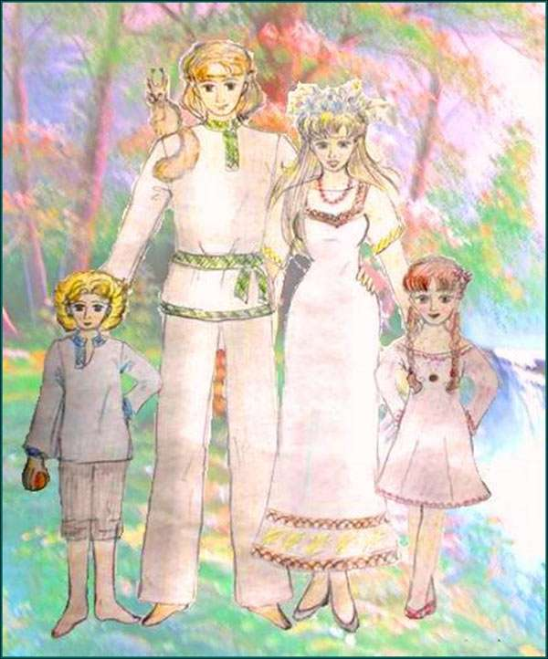
Cinquain.
Family
Happy and friendly.
Educates,consolidates,protects.
It should be cherished each.
Parents.

Slide 17
Ask and answer your classmates about your families.
1) How old are you?
2) Is your family large? How many are you in your family?
3) Have you got any brothers or sisters?
4) What are your parents? Where do they work?
5) How long have your parents been married?
6) Do they have much in common?
7) Do you spend a lot of time with your family?
8) What sort of things do you do together?
9) Do you go out with your parents?
10) Can you describe your mother (father, sister, brother, friend)?

Slide 18
Fill in the missing words:
1) My mother’s sister is my … and her brother is my …
2) My wife’s mother is my … and her father is my …
3) My wife’s sister is my … and my wife’s brother is my …
4) My uncle’s son is my … and my aunt’s daughter is my … too.
5) My mother has a sister, her son is my mother’s …
6) My father has a brother, his daughter is my father’s …

Slide 19
Claster: name as many words as you know.
grandparents
parents
relatives
family

Slide 20
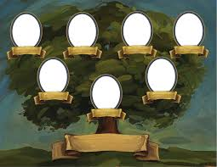
H/t: Make your own family tree!

Slide 21
The lesson is over. Goodbye.

