Slide 1
Irregular Verbs
Notes:
The original was copied from www. And has been modified by Don Fisher.

Slide 2
COMMON IRREGULAR VERBS
blow
Present | Past | Past Participle
? | ? | ?
Can you list these verb forms?

Slide 3
COMMON IRREGULAR VERBS
blow
Present | Past | Past Participle
blow | blew | blown

Slide 4
break
Present | Past | Past Participle
? | ? | ?
Can you list these verb forms?

Slide 5
break
Present | Past | Past Participle
break | broke | broken

Slide 6
catch
Present | Past | Past Participle
? | ? | ?
Can you list these verb forms?

Slide 7
catch
Present | Past | Past Participle
catch | caught | caught

Slide 8
choose
Present | Past | Past Participle
? | ? | ?
Can you list these verb forms?

Slide 9
chose
Present | Past | Past Participle
chose | chose | chosen

Slide 10
come
Present | Past | Past Participle
? | ? | ?
Can you list these verb forms?

Slide 11
come
Present | Past | Past Participle
come | came | come

Slide 12
do
Present | Past | Past Participle
? | ? | ?
Can you list these verb forms?

Slide 13
do
Present | Past | Past Participle
do | did | done

Slide 14
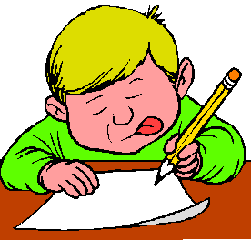
draw
Present | Past | Past Participle
? | ? | ?
Can you list these verb forms?

Slide 15
draw
Present | Past | Past Participle
draw | drew | drawn

Slide 16
drink
Present | Past | Past Participle
? | ? | ?
Can you list these verb forms?

Slide 17
drink
Present | Past | Past Participle
drink | drank | drunk

Slide 18
dream
Present | Past | Past Participle
? | ? | ?
Can you list these verb forms?

Slide 19
dream
Present | Past | Past Participle
dream | dreamt/dreamed | dreamt/ dreamed

Slide 20
drive
Present | Past | Past Participle
? | ? | ?
Can you list these verb forms?

Slide 21
drive
Present | Past | Past Participle
drive | drove | driven

Slide 22
eat
Present | Past | Past Participle
? | ? | ?
Can you list these verb forms?

Slide 23
eat
Present | Past | Past Participle
eat | ate | eaten

Slide 24
fall
Present | Past | Past Participle
? | ? | ?
Can you list these verb forms?

Slide 25
fall
Present | Past | Past Participle
fall | fell | fallen

Slide 26
forgive
Present | Past | Past Participle
? | ? | ?
Can you list these verb forms?

Slide 27
forgive
Present | Past | Past Participle
forgive | forgave | forgiven

Slide 28
get
Present | Past | Past Participle
? | ? | ?
Can you list these verb forms?

Slide 29
get
Present | Past | Past Participle
get | got | gotten

Slide 30
go
Present | Past | Past Participle
? | ? | ?
Can you list these verb forms?

Slide 31
go
Present | Past | Past Participle
go | went | gone

Slide 32
grow
Present | Past | Past Participle
? | ? | ?
Can you list these verb forms?

Slide 33
grow
Present | Past | Past Participle
grow | grew | grown

Slide 34
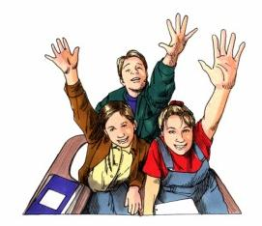
know
Present | Past | Past Participle
? | ? | ?
Can you list these verb forms?

Slide 35
know
Present | Past | Past Participle
know | knew | known

Slide 36
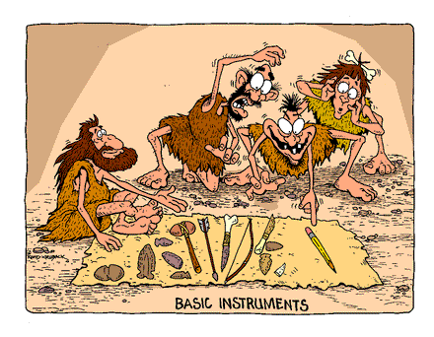
lay
Present | Past | Past Participle
? | ? | ?
Can you list these verb forms?

Slide 37
lay
Present | Past | Past Participle
lay | laid | laid

Slide 38
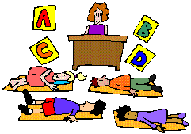
lie
Present | Past | Past Participle
? | ? | ?
Can you list these verb forms?

Slide 39
lie
Present | Past | Past Participle
lie | lay | lain

Slide 40
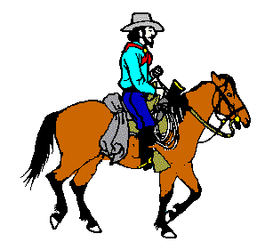
ride
Present | Past | Past Participle
? | ? | ?
Can you list these verb forms?

Slide 41
ride
Present | Past | Past Participle
ride | rode | ridden

Slide 42
run
Present | Past | Past Participle
? | ? | ?
Can you list these verb forms?

Slide 43
run
Present | Past | Past Participle
run | ran | run

Slide 44
see
Present | Past | Past Participle
? | ? | ?
Can you list these verb forms?

Slide 45
see
Present | Past | Past Participle
see | saw | seen

Slide 46
sing
Present | Past | Past Participle
? | ? | ?
Can you list these verb forms?

Slide 47
sing
Present | Past | Past Participle
sing | sang | sung

Slide 48
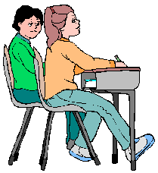
sit
Present | Past | Past Participle
? | ? | ?
Can you list these verb forms?

Slide 49
sit
Present | Past | Past Participle
sit | sat | sat

Slide 50
speak
Present | Past | Past Participle
? | ? | ?
Can you list these verb forms?

Slide 51
speak
Present | Past | Past Participle
speak | spoke | spoken

Slide 52
swim
Present | Past | Past Participle
swims | swam | swum
?
?
?
Can you list these verb forms?

Slide 53
swim
Present | Past | Past Participle
swim | swam | swum

Slide 54
take
Present | Past | Past Participle
? | ? | ?
Can you list these verb forms?

Slide 55
take
Present | Past | Past Participle
take | took | taken

Slide 56
throw
Present | Past | Past Participle
? | ? | ?
Can you list these verb forms?

Slide 57
throw
Present | Past | Past Participle
throw | threw | thrown

Slide 58
write
Present | Past | Past Participle
? | ? | ?
Can you list these verb forms?

Slide 59
write
Present | Past | Past Participle
write | wrote | written

