Slide 1
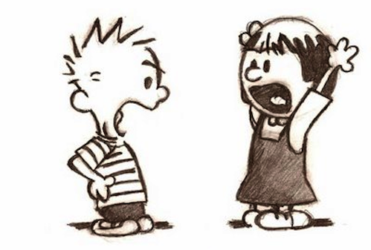
Conflicts

Slide 2
The social processes can broadly be divided into two categories. One is associative social process and the other is dissociative social process.
The process that make special contribution towards social differentiation, antagonism and division are called dissociative processes. Conflict, competition and mutual opposition are included in dissociative processes.
Like co-operation conflict is also regarded as a basic action. In this context A.W. Small says that conflict is the fundamental form of opposition oriented relationship and dissociative interaction. Karl Marx, George Simmel, Rulf Dahrendorf have analysed the role of conflict in social structure.
A.W. Green says that “Conflict is the deliberate attempt to oppose, resist or force the will of another or others.”

Slide 3
Characteristics of Conflict
1. Universal Process
Conflict is universal process. It is found everywhere and at all times. It exists in each and every part of human society. In some societies conflict may be very acute while in some other societies it is very mild.

Slide 4
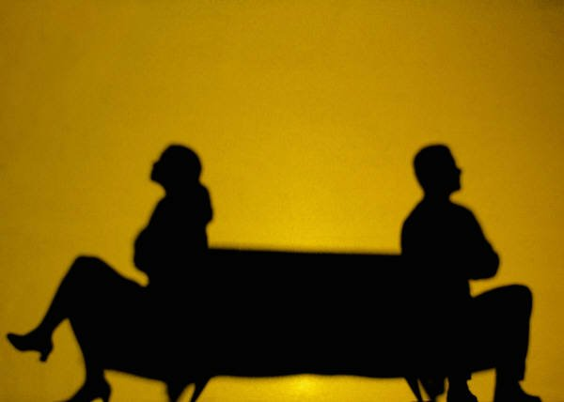
2. Conscious Process
Individuals or groups who are involved in conflict are aware of the fact that they are conflicting. The attention of every individual is fixed on his rival rather than on reward.

Slide 5
3. Personal Activity
Conflict is a personal activity in which the aim of one party is to eliminate the opposite party. The conflicting parties personally know each other. When competition is personalised it leads to conflict.
4. Intermittent Process
Conflict never takes place, continuously. It takes place occasionally. No, society can sustain in a state of continuous conflict.
5. Emotional Process
The basis of conflict lies in emotion. Due to emotional character of man people get involved in conflict. Due to such character of individual he uses not only fair but also unfair means to attain the end.

Slide 6
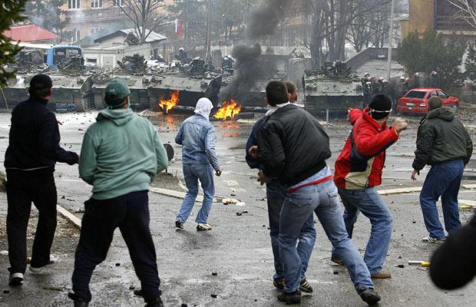
7. Conflict May Be Violent and Non-violent
Conflict may be violent or non-violent in nature. Normally conflict is associated with violence. When it is violent it retards progress of society and when it is non-violent it brings development in society.

Slide 7
Thanks For Attention

